Slide 1
Cake Decorating 101
Stephanie Erwin
cakesaplenty.com

Slide 2
How I got started…

Slide 3
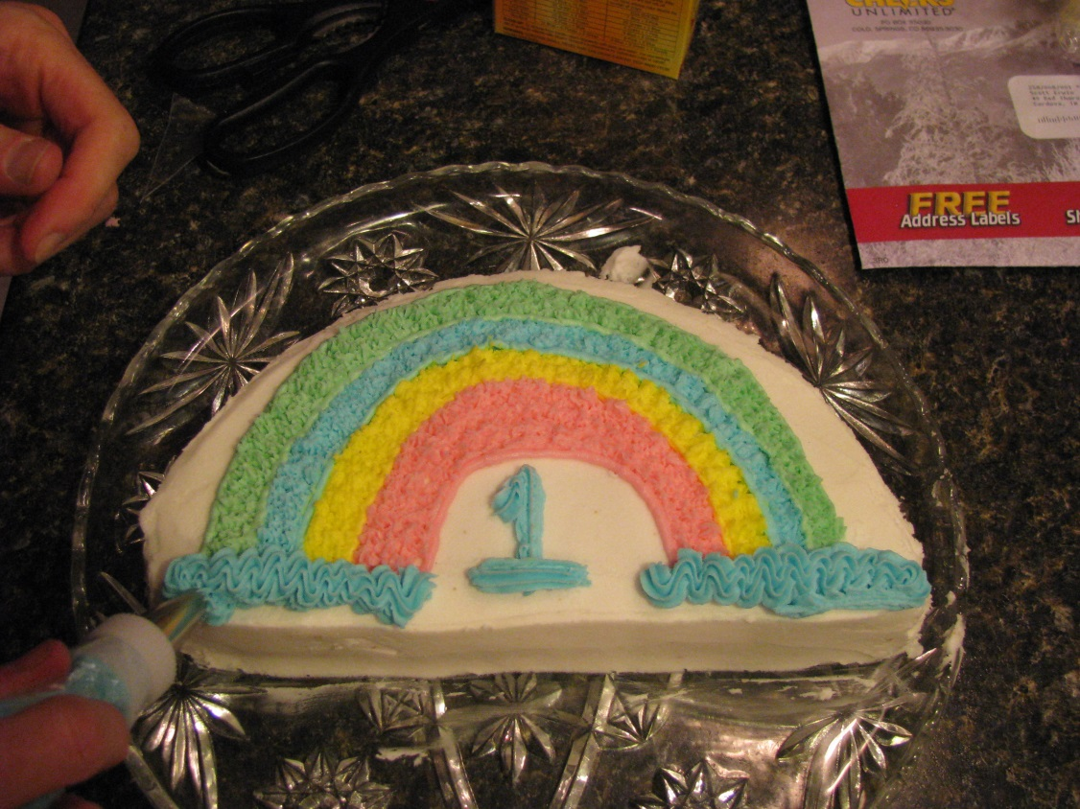
My first cake!

Slide 4
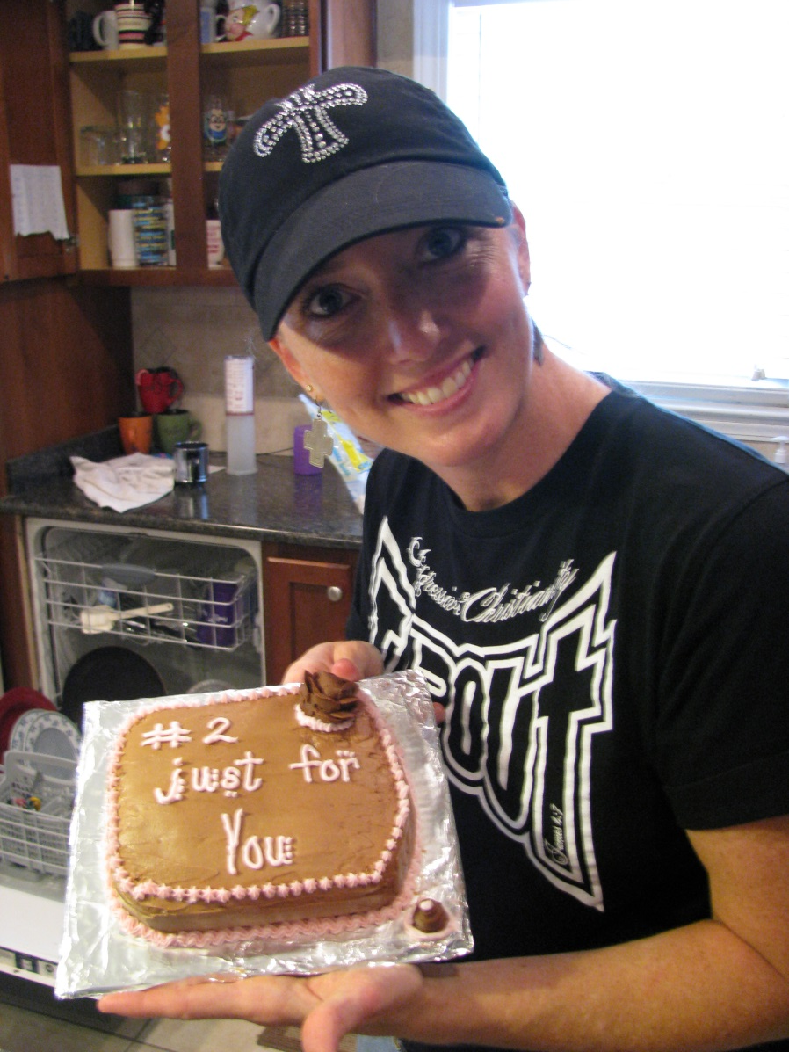
My second try!

Slide 5
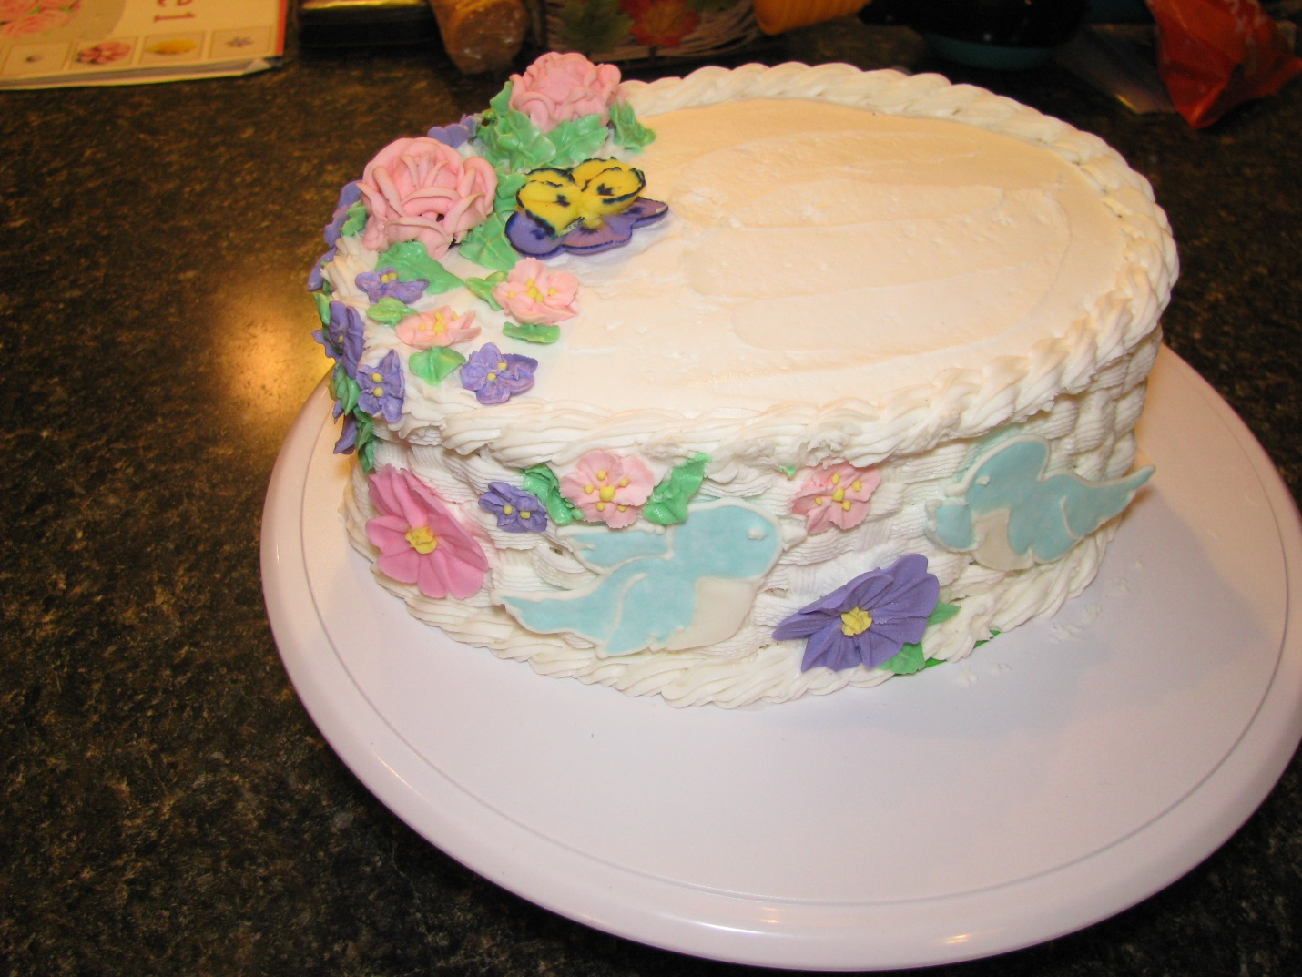
Getting better…3rd cake!

Slide 6
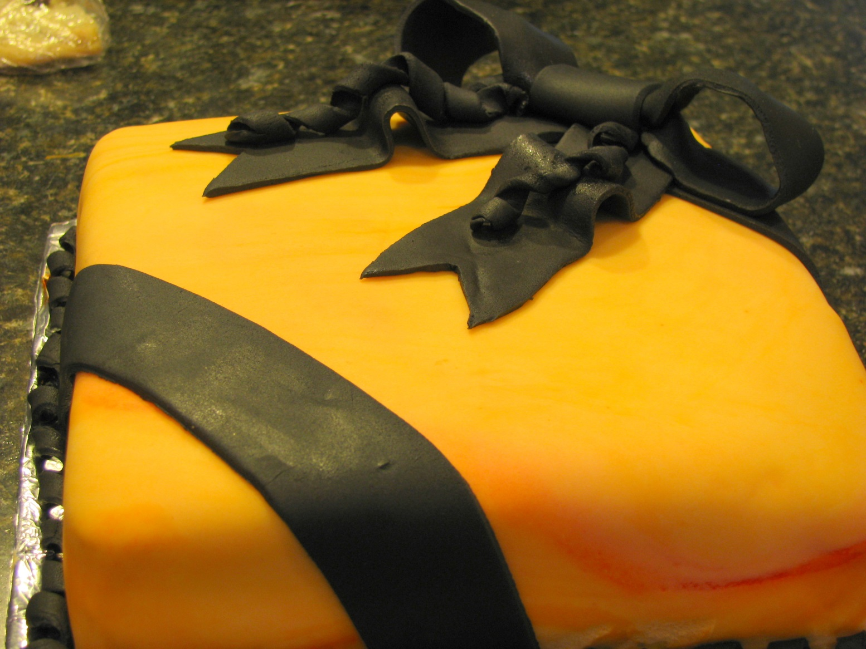
Four with Fondant!

Slide 7
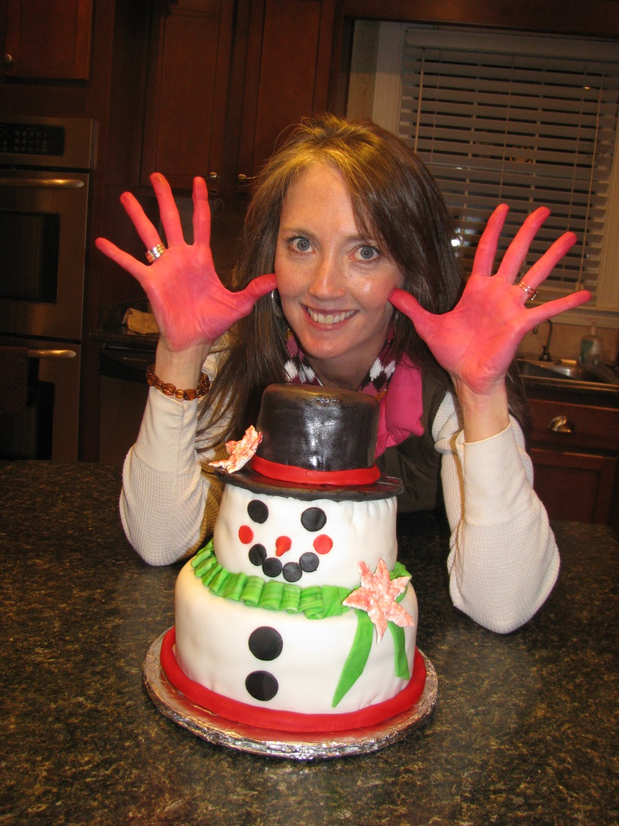
Fun with Five!

Slide 8
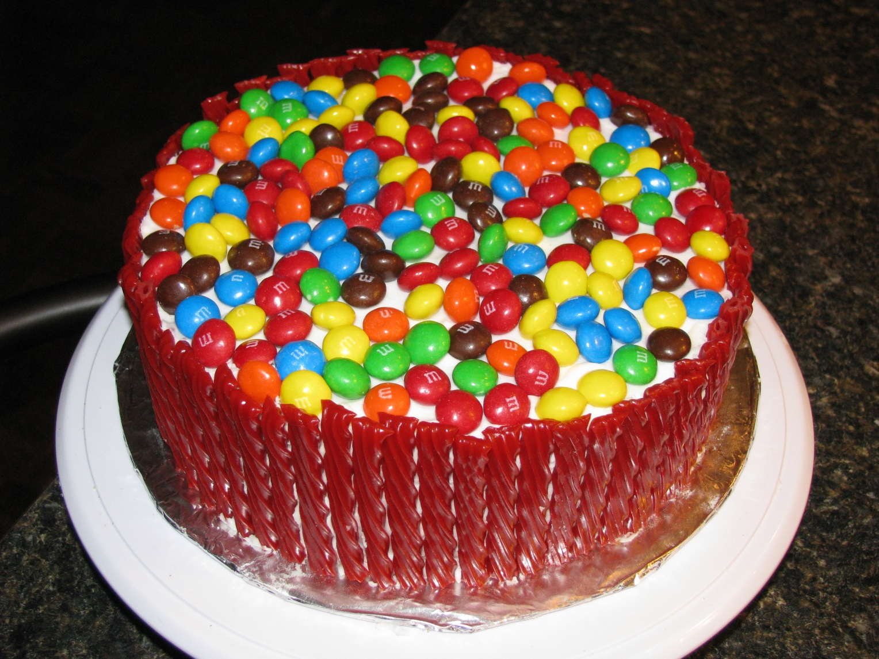
My birthday cake for the kids!

Slide 9
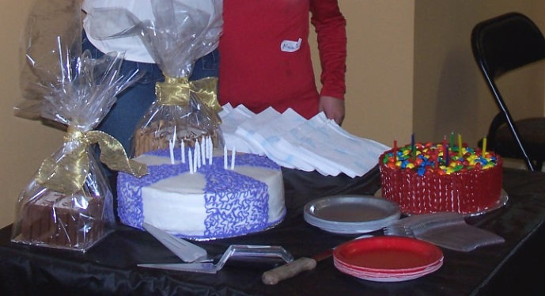
4 months later…

Slide 10
Our Agenda
The Basics
  Supplies
  Leveling
  Crumb-coating
  Icing
  Structure

Slide 11
Our Agenda
Decorating!
  Borders
  Ideas
  Buttercream Transfers
Questions?

Slide 12
Basics: Supplies
My supplies: tips/bags, bench scrapper, fondant letters, spatulas, turntable, leveler (serrated knife should be a bread cutting knife, less harsh than a bigger tooth serrated knife), etc.
Your supplies: Tip, bags, cake form, bench scrapper, plastic spoon, paper towels, copies, etc.

Slide 13
Basics: Leveling
Freeze your cakes long enough to get them firm
Helps prevent them from tearing as you are leveling
Freeze them after you have leveled them and it will help when you are handling them

Slide 14
Leveling cont…
3 ways…
  With a cake leveler
  With a knife outside of the pan
  While inside the pan

Slide 15
Basics: Crumb-coating
Use the largest tip you have to put a border around the edge of your layers
Then, simply fill them in
Do the same on the sides—this will help you not pull crumbs into the icing

Slide 16
Basics: Icing
Different types of icing:
  SMBC
  IMBC
  TBC
    Crusting and non-crusting

Slide 17
Basics: Icing cont…
Website: CakeCentral.com
http://cakecentral.com/t/682196/icing-a-cake

Slide 18
Buttercream Recipe
- 2 cups of butter
- 2 cups of hi ratio shortening
- Flavorings
- 4 pounds of confectioners’ sugar 10x
- 3 tablespoons of hot water (depending on the weather)

Slide 19
Basics: Structure
If your cake is multi-tier you need 4 supports per tier and a dowel down the center.
  Use wooden dowels for supports
  Can use jumbo straws as well

Slide 20
Decorating: Borders
Video: Using a Star Tip
Video: Another idea

Slide 21
Decorating:Ideas
Lots of Tutorials!
Candlewicking
Vertical ruffle part 1 and part 2
Stacked ruffle
Rose cake
Chantilly cake

Slide 22
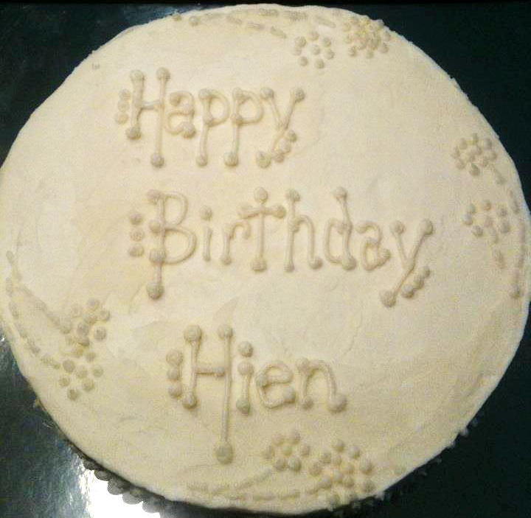
Candlewicking

Slide 23
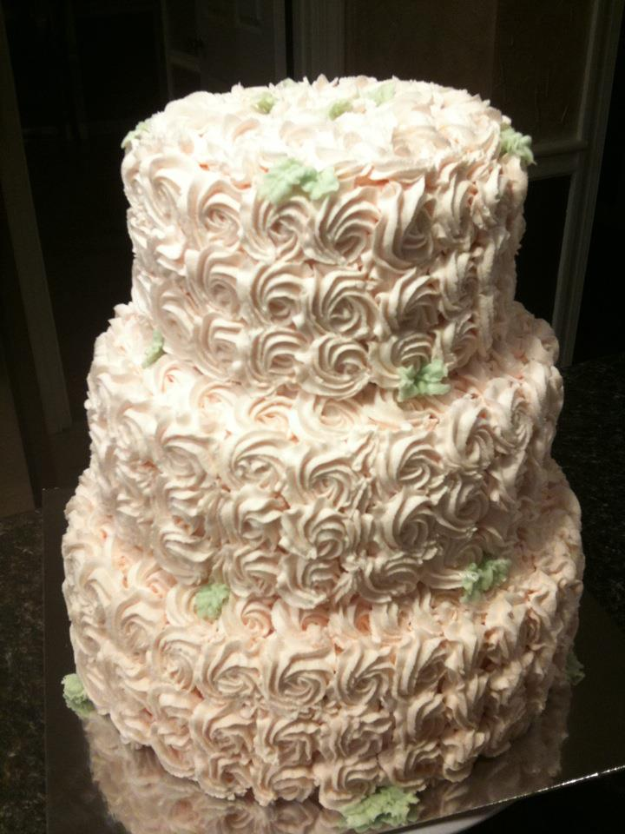
Sample Rose Cake

Slide 24
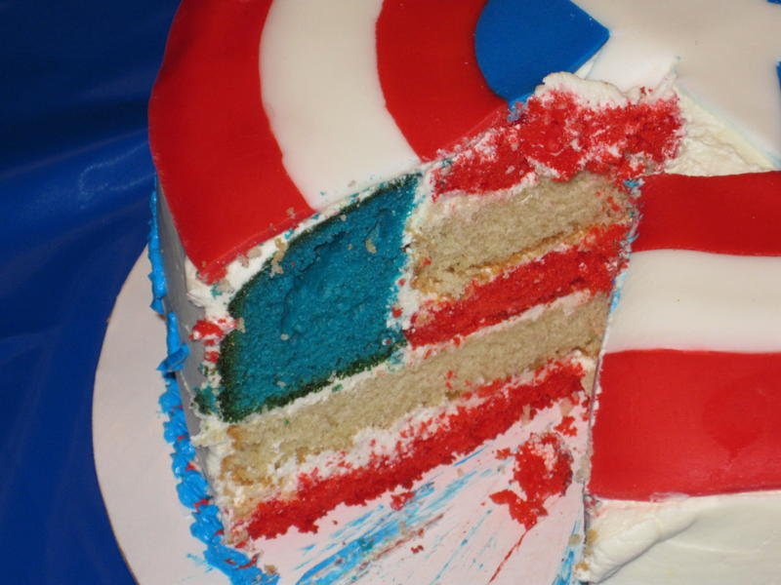
Decorate the Inside!!

Slide 25
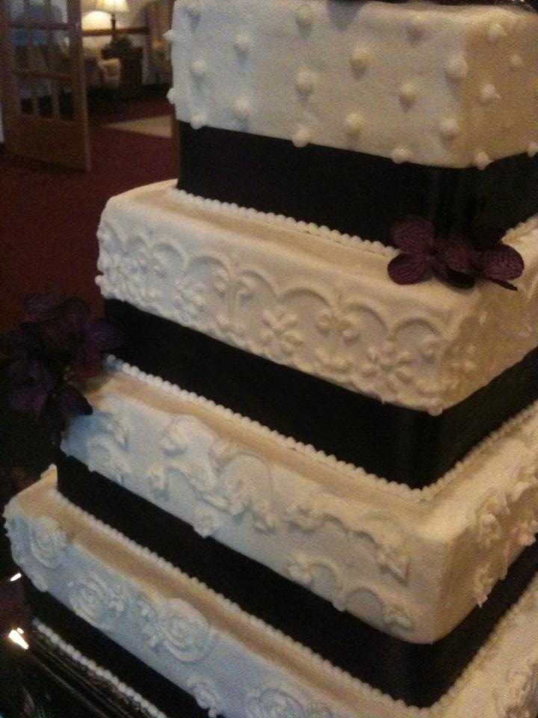
Flowers
&
Ribbon

Slide 26
Decorating: Buttercream Transfers
Video

Slide 27
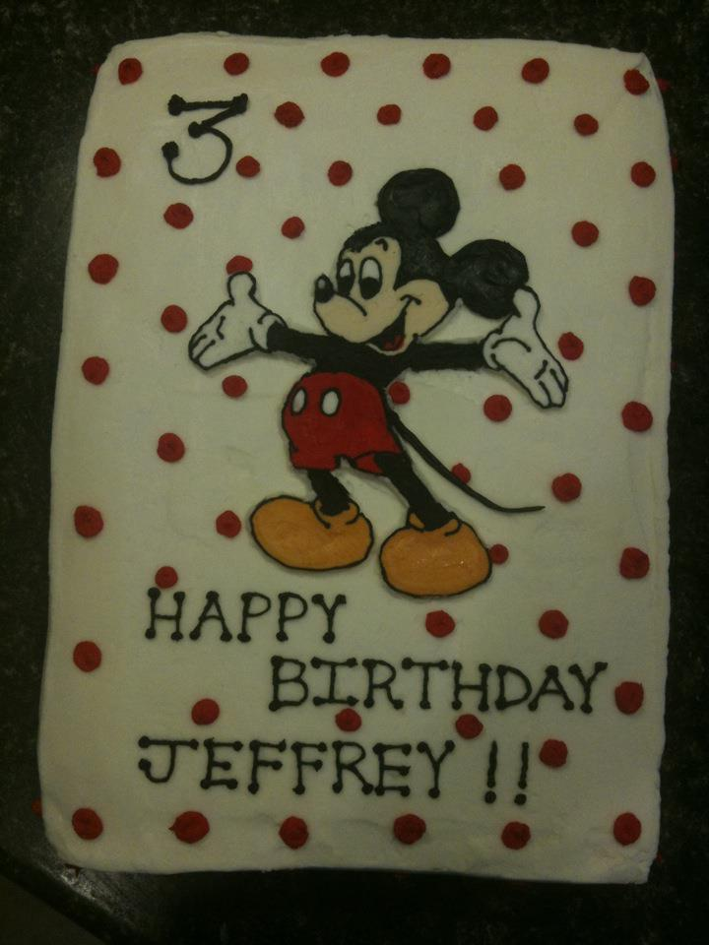
Sample BCT

Slide 28
Questions?
Stephanie Erwin
stephanie@cakesaplenty.com
www.cakesaplenty.com

